Slide 1
MCDA 5550 – Responsive Web App Development Chapter 01: Introduction
Instructor: Dinesh KG

Slide 2
Variability of computing platforms
Desktops/laptops/netbooks for professional computing
Tablets, smartphones, smart TVs, wearable devices, etc for home/personal computing

Slide 3
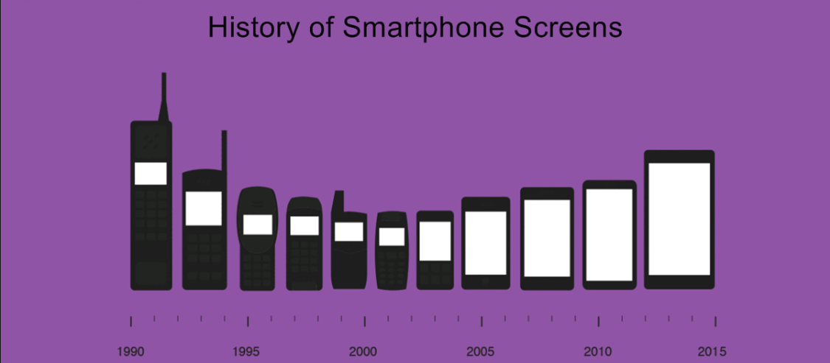
Evolution

Slide 4
Why mobile apps different?
Unique interactions:
Short interaction
Often ~ 2 minutes
Touch input
Target size matters
Thumbs
Right vs left handed

Slide 5
Context of use
On the bus/train
Standing in line
In a coffee shop
Laying in bed
Sitting on the toilet!
… and in class?

Slide 6
Limited resources
Limited screen space
Battery life
Less powerful CPUs
Less RAM
Connection speed in certain areas

Slide 7
So, should mobile apps be different? (from desktops/laptops)
Functionality, (often) NO!
People often expect the similar features as the desktop counterparts
Interface design, YES of course!
For the reasons listed earlier

Slide 8
Simple, easy-to-understand UI
People don’t want to read manuals on how to use 99¢ apps!!
Everyone knows to code. Compromise on UI/UX?

Slide 9
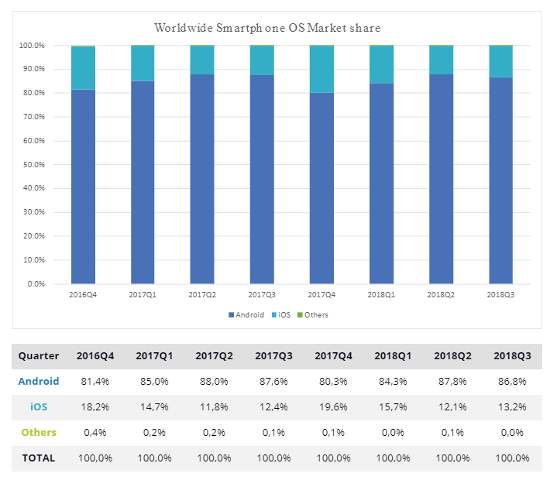
Facts
Major mobile OS: Android (Google), iOS (Apple), Windows RT (MS)
with several other competing platforms including Blackberry, Firefox, and Ubuntu/Linux
http://www.idc.com/prodserv/smartphone-os-market-share.jsp

Slide 10
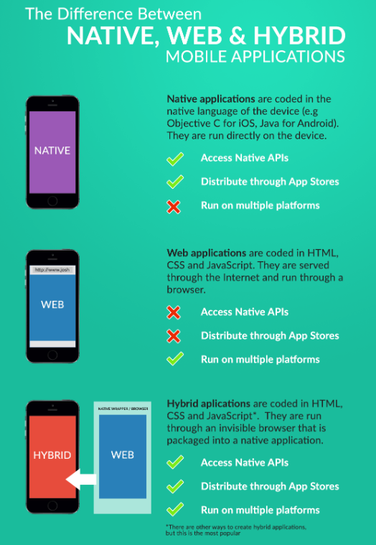
Native/Web/Hybrid
Image source:
https://www.joshmorony.com/media/2014/01/nativewebhybrid.png

Slide 11
Development environment
Native apps
iOS – objective-C and Swift
Android – Java
Windows – .Net framework (C#, VB, etc)
Requirements
IDE – (Xcode, Android Studio, Visual Studio)
SDK – (iOS SDK, android-sdk, Windows Sdk)
Emulators – ( iOS Simulator, AVD, MS Device Emulator)
Mobiles (Real phones – deploy through USB, Wifi)

Slide 12
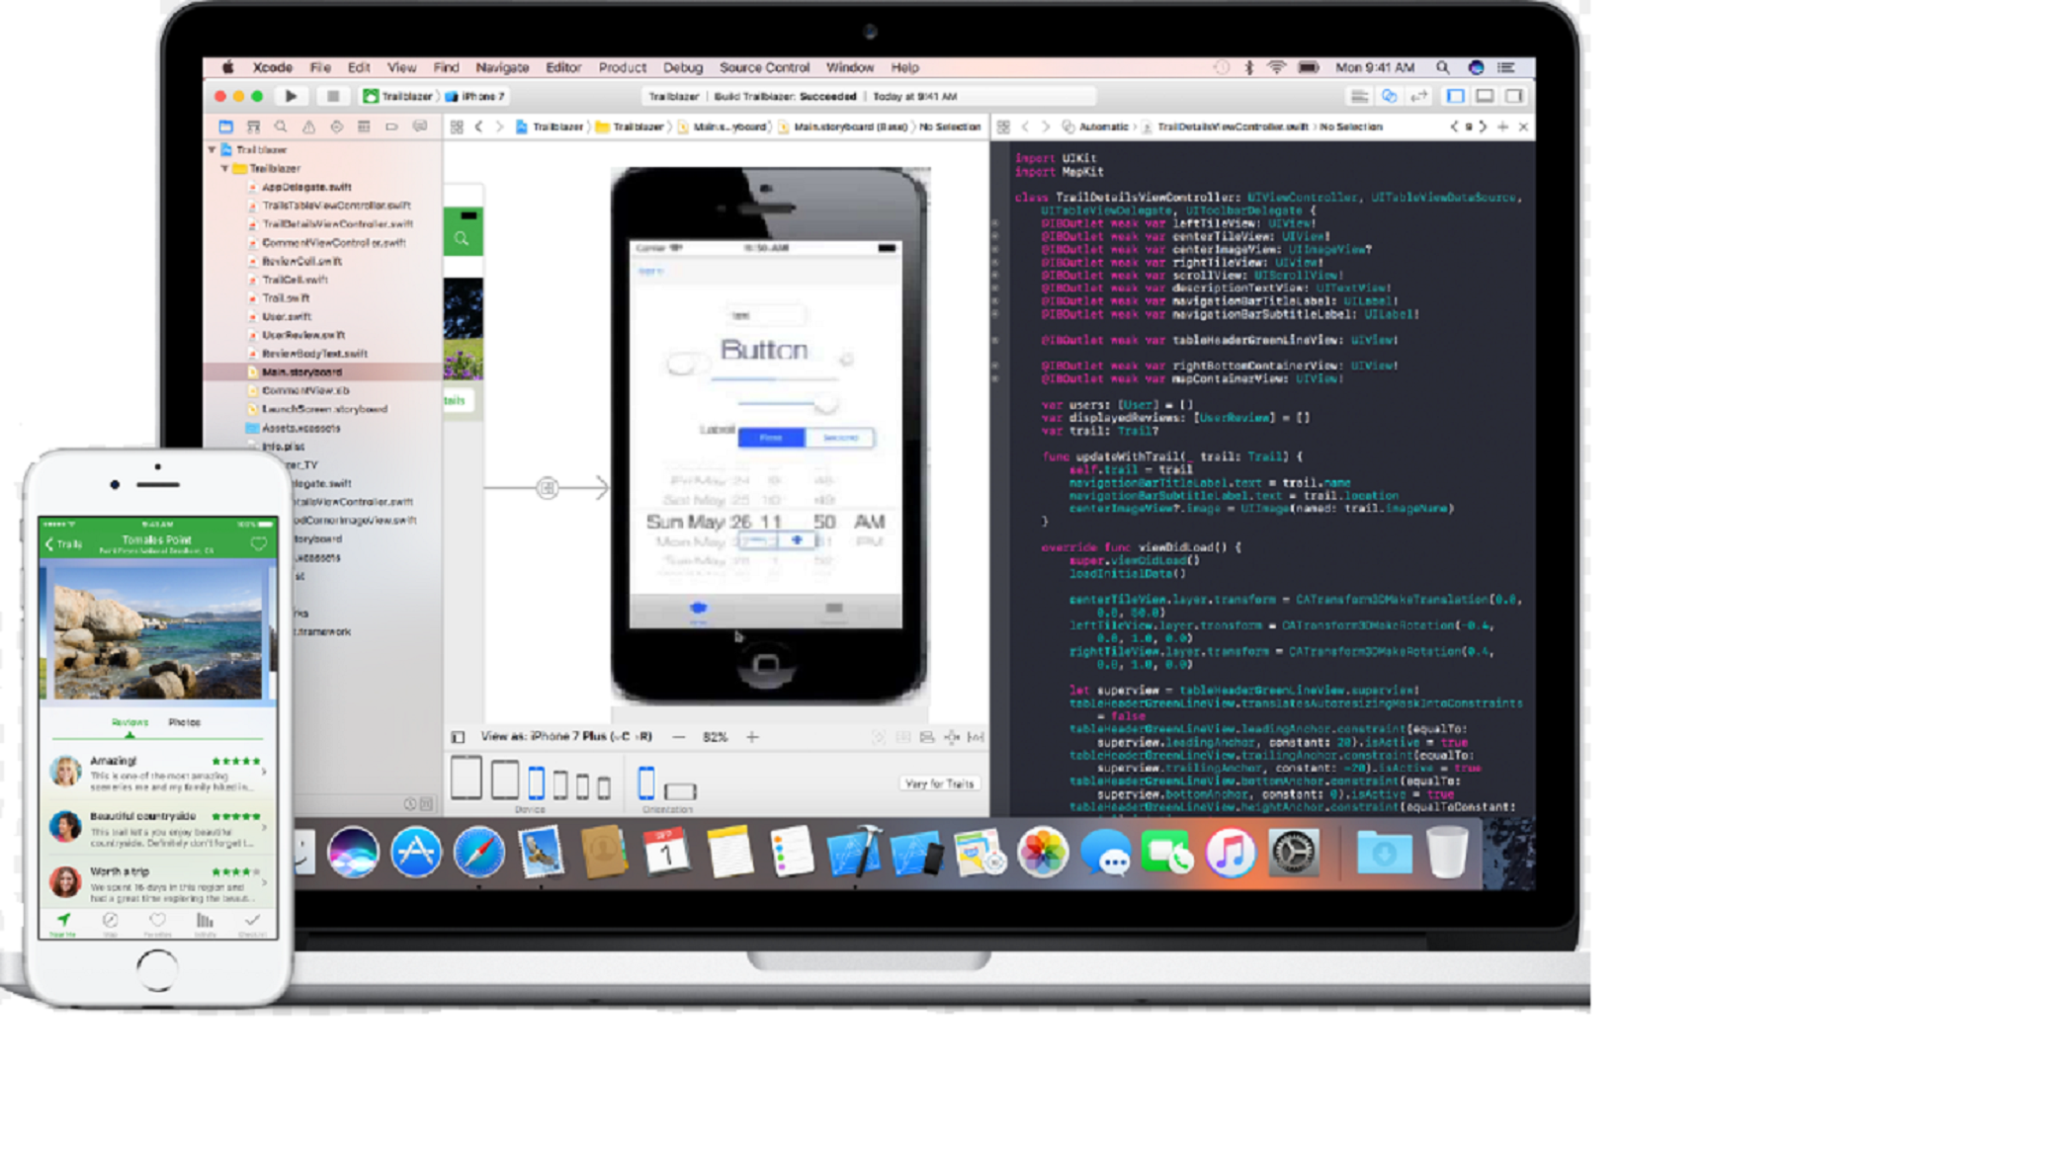
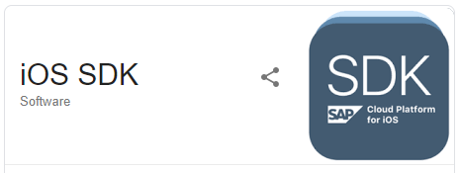
Native - ios

Slide 13
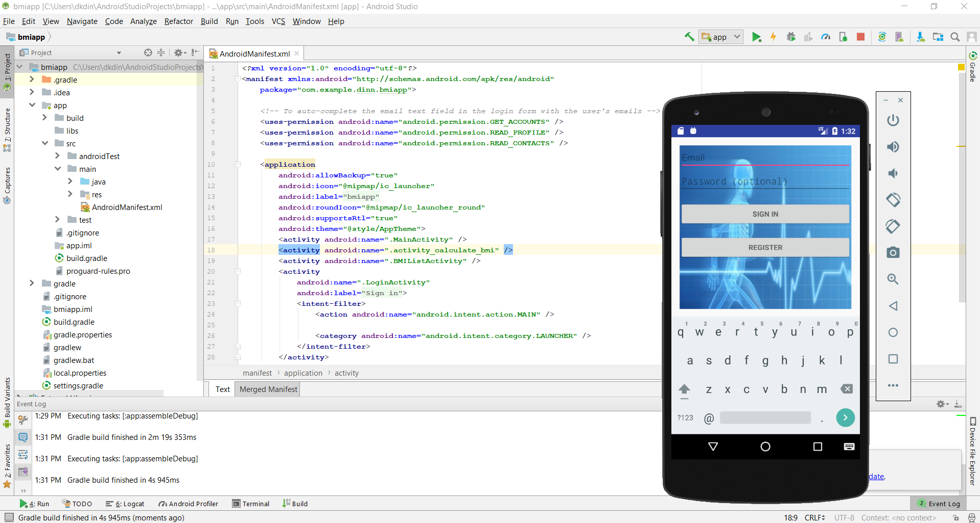
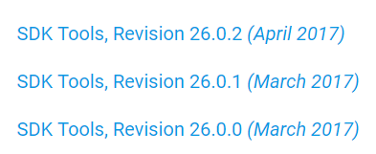
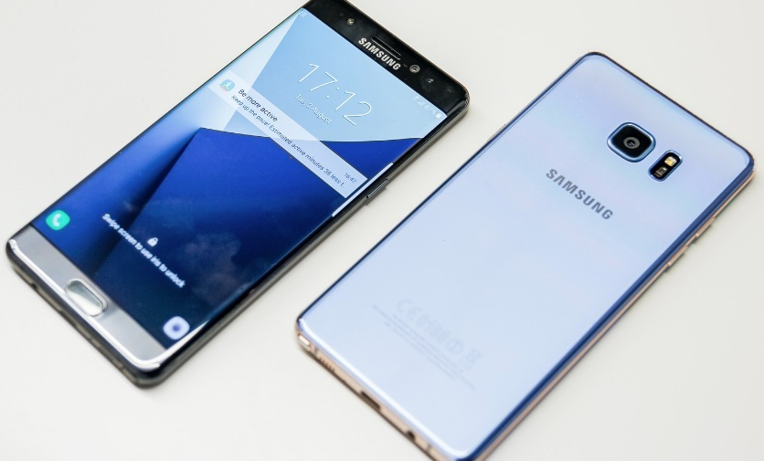
Native - android

Slide 14
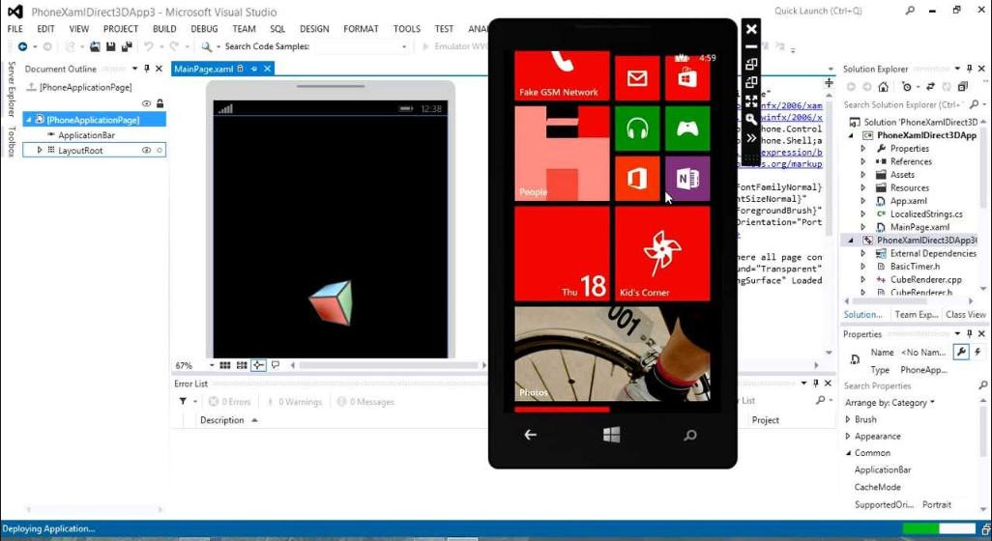
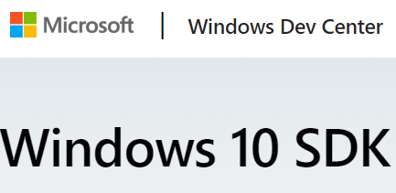
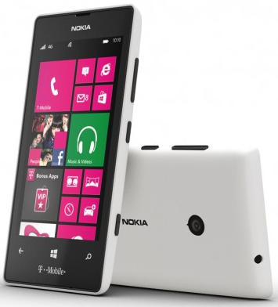
Native - windows

Slide 15
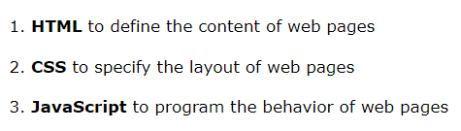
Development environment
Responsive Mobile Web apps
Web-based technologies
HTML5
CSS3
JavaScript
jQuery
JSON

Slide 16

Development environment
Hybrid:
In this course:
Write apps in HTML/CSS/JavaScripts
Convert/compile for native platforms

Slide 17
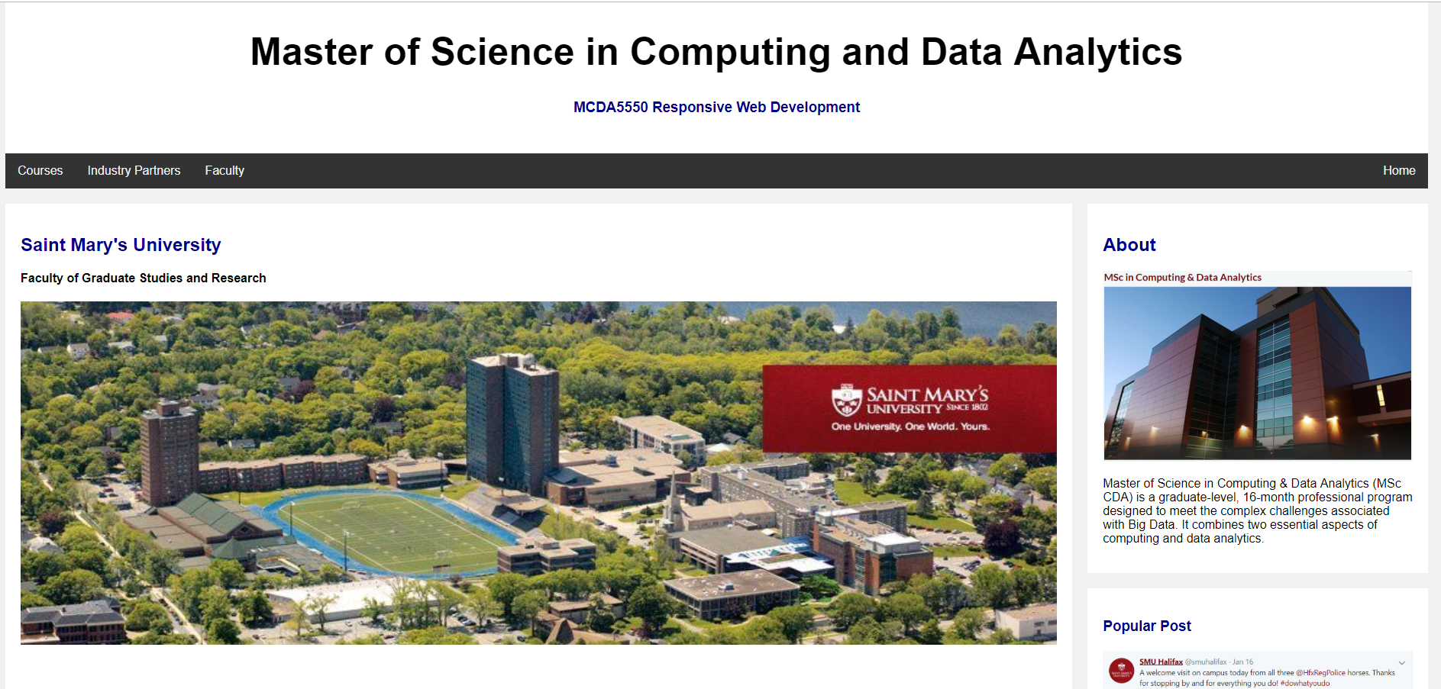
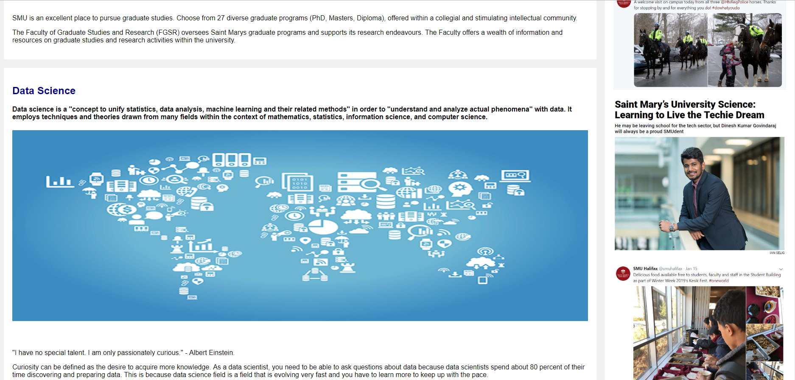
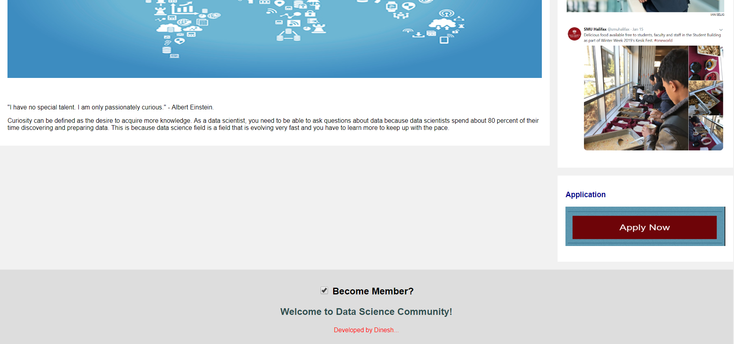
Example: Mcda App
https://rdnzg1nyiwdjgtbjnw7uyw-on.drv.tw/McdaApp/www/

Slide 18
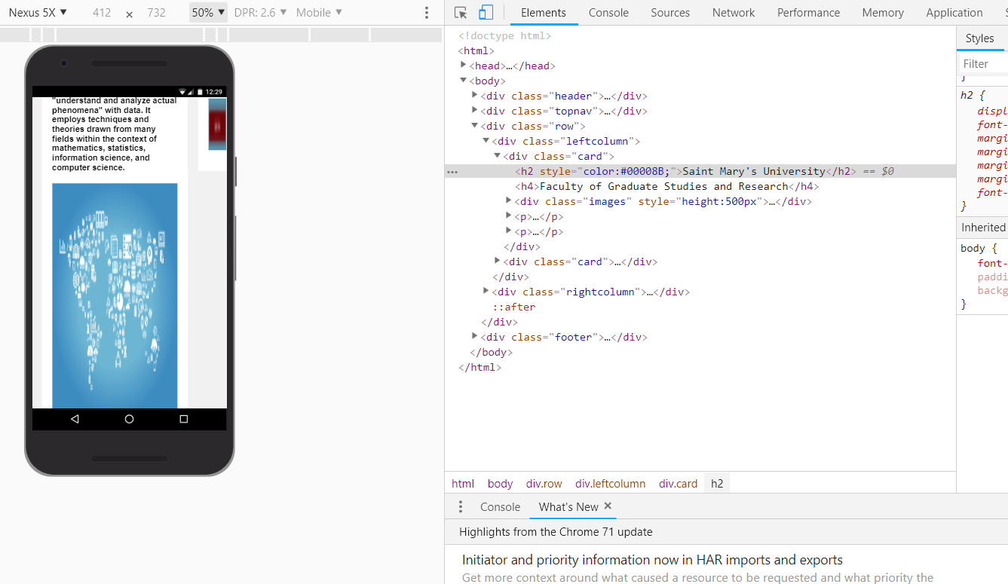
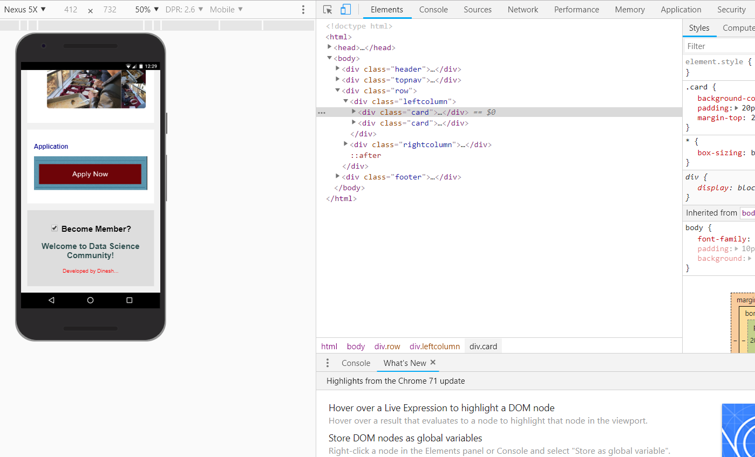
Web App vs Responsive App
Source: All SMU image sources on app - https://smu.ca/ (educational purpose)

Slide 19
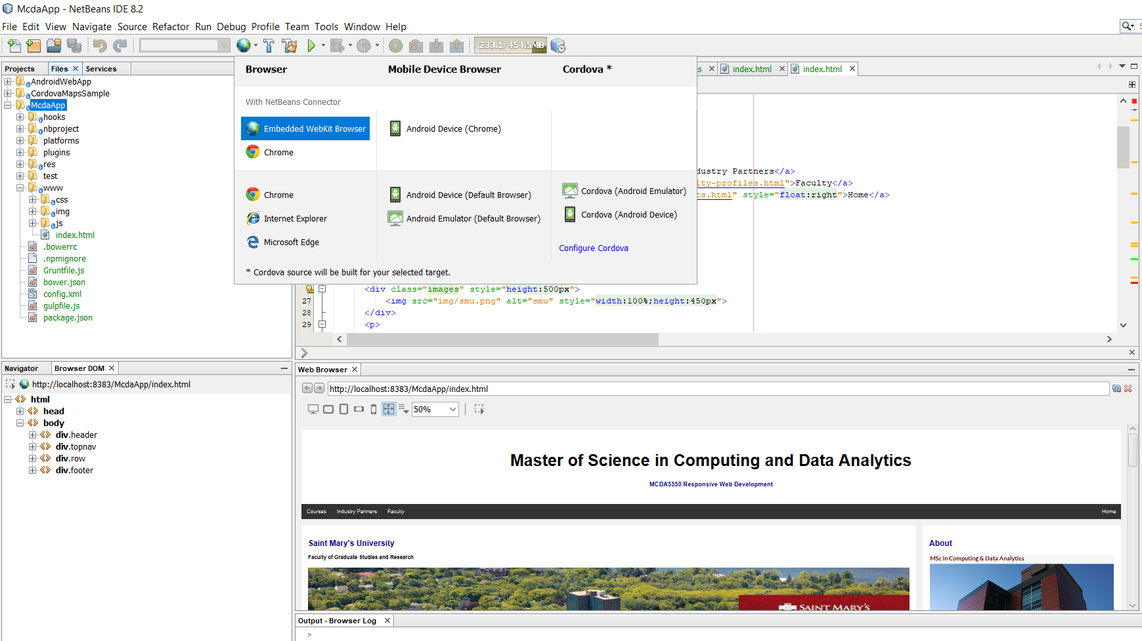
Netbeans IDE

Slide 20
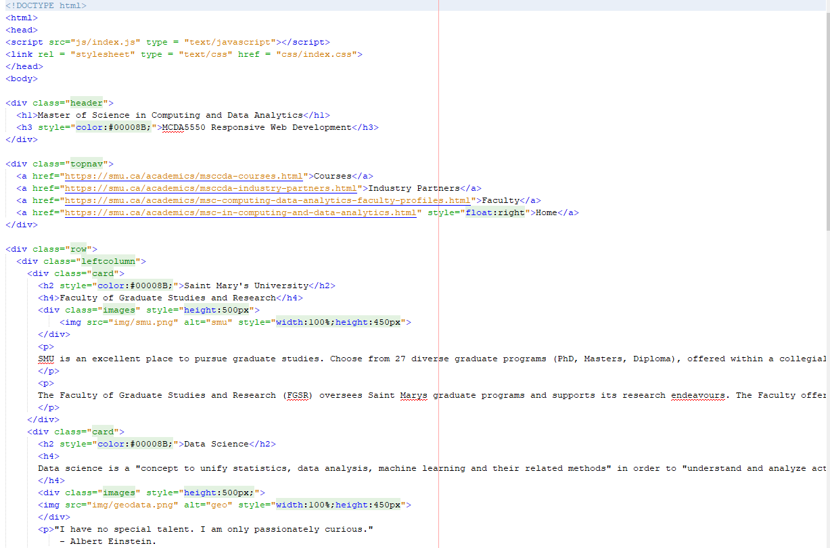
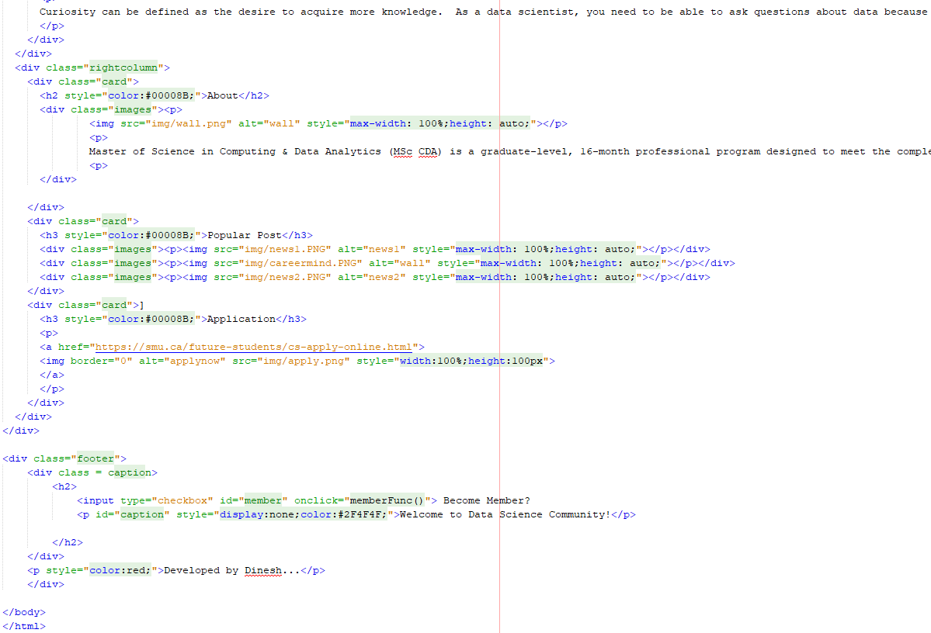
Mcda App - HTML

Slide 21
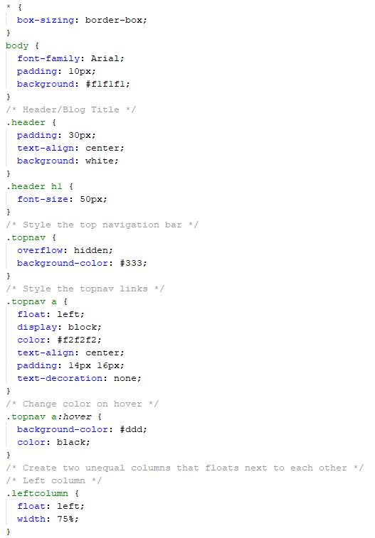
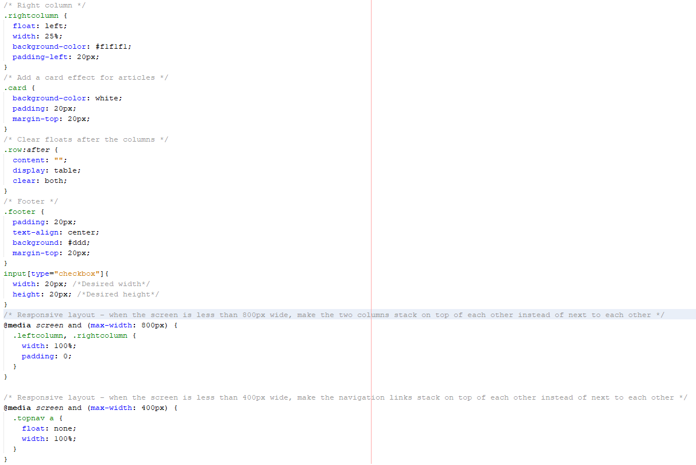
Mcda App - CSS

Slide 22
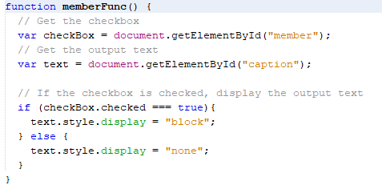
Mcda App - JavaScript

Slide 23
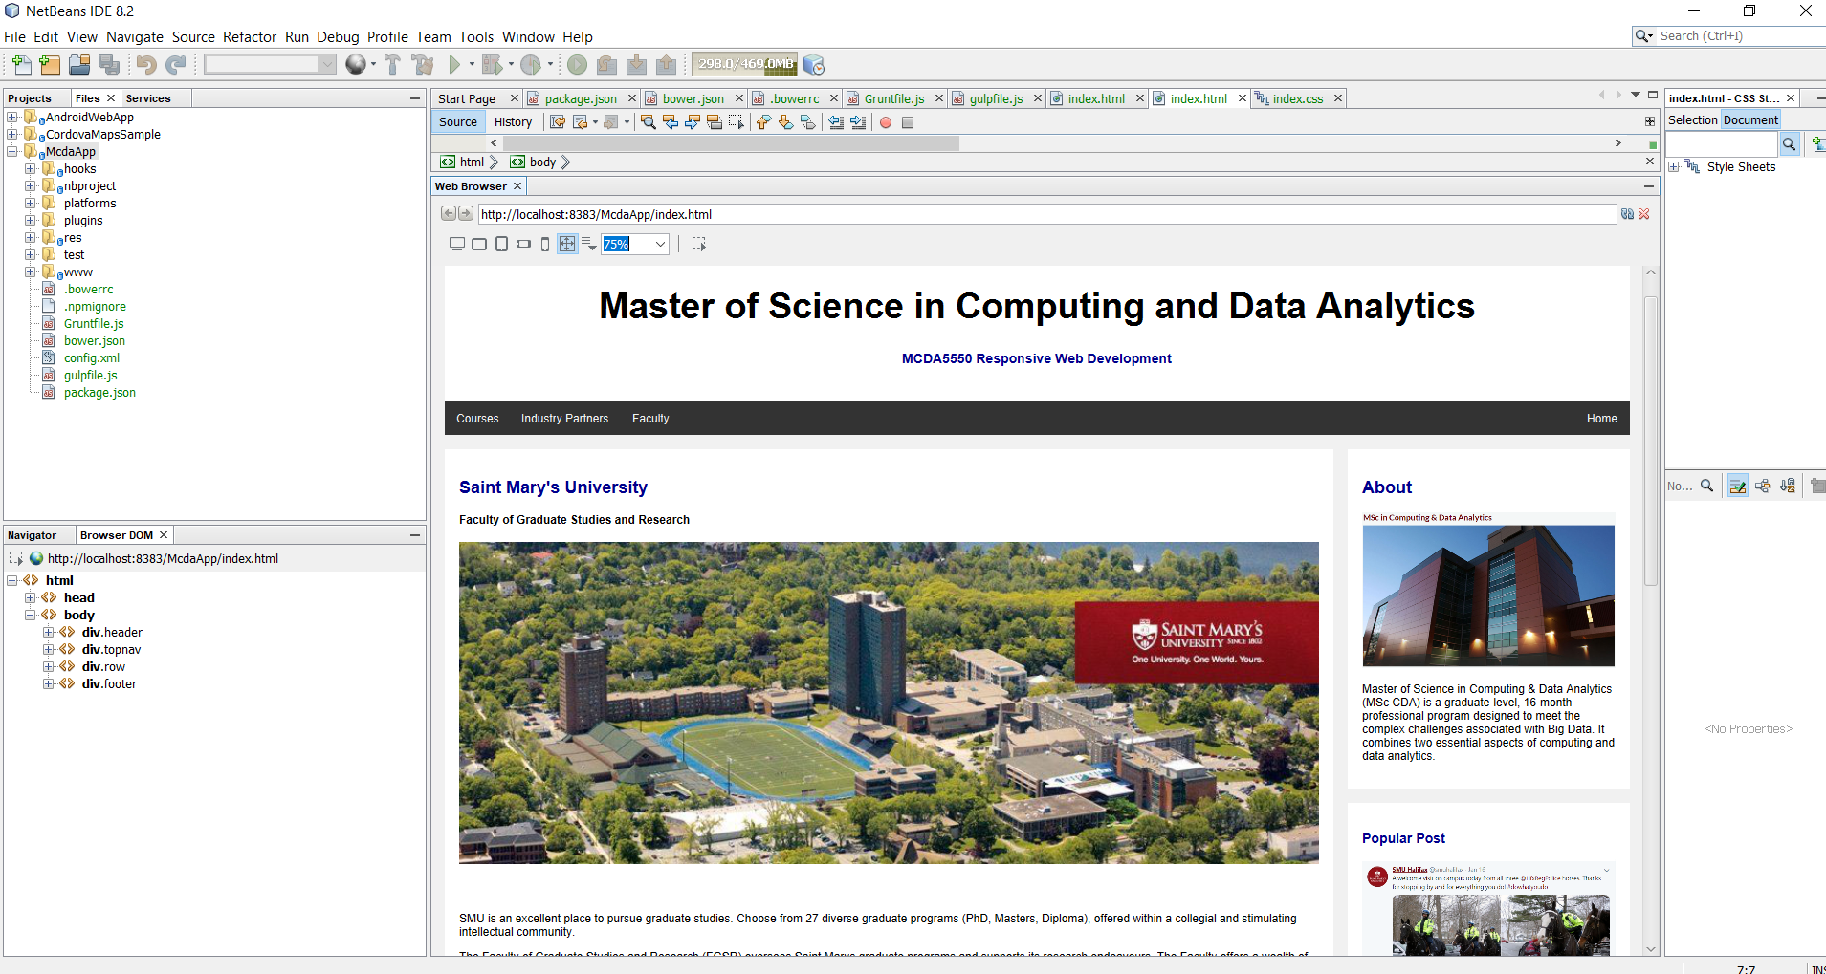
Mcda App – IDE Browser

Slide 24
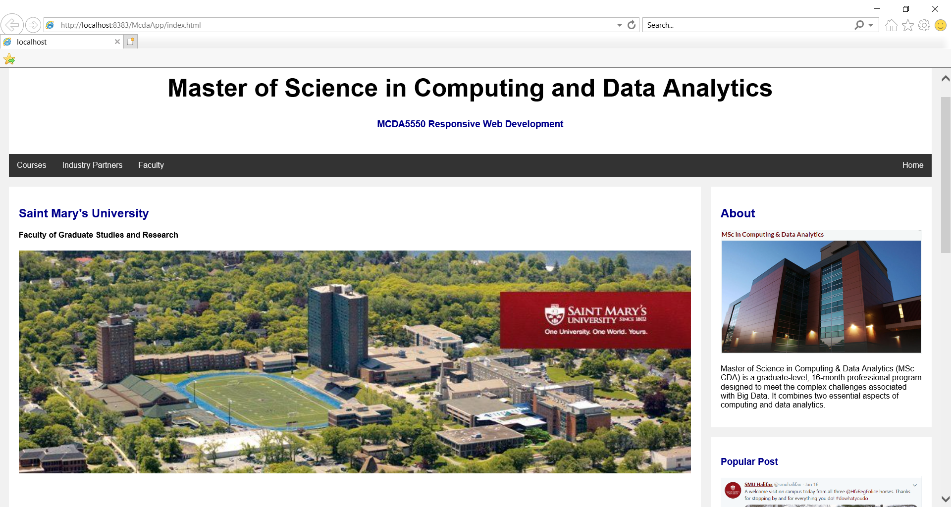
Mcda App – Internet Explorer

Slide 25
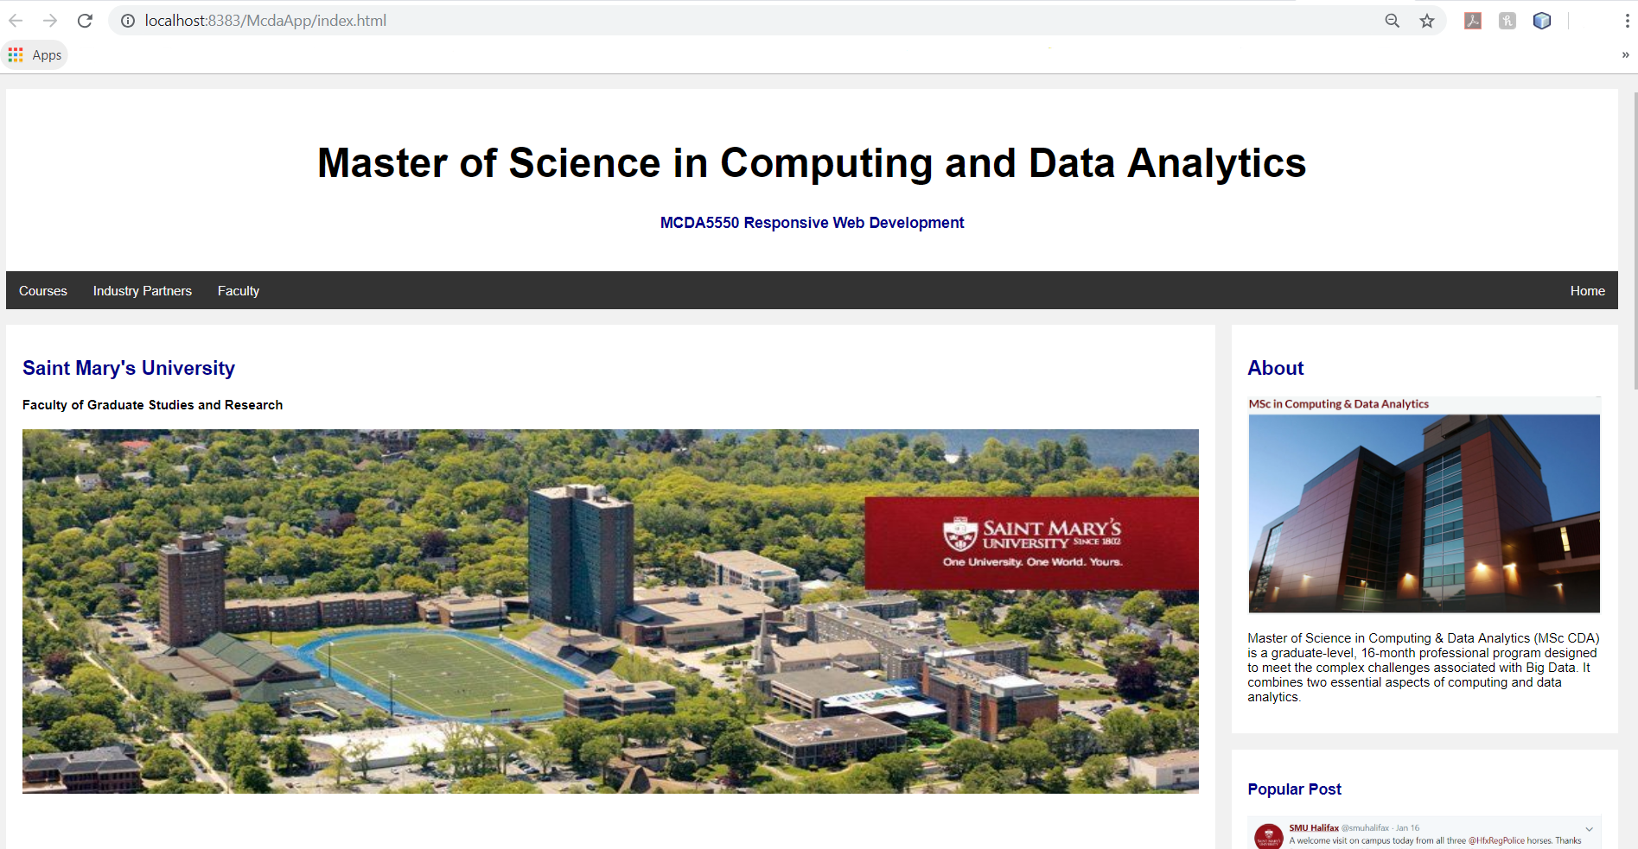
Mcda App – Chrome

Slide 26
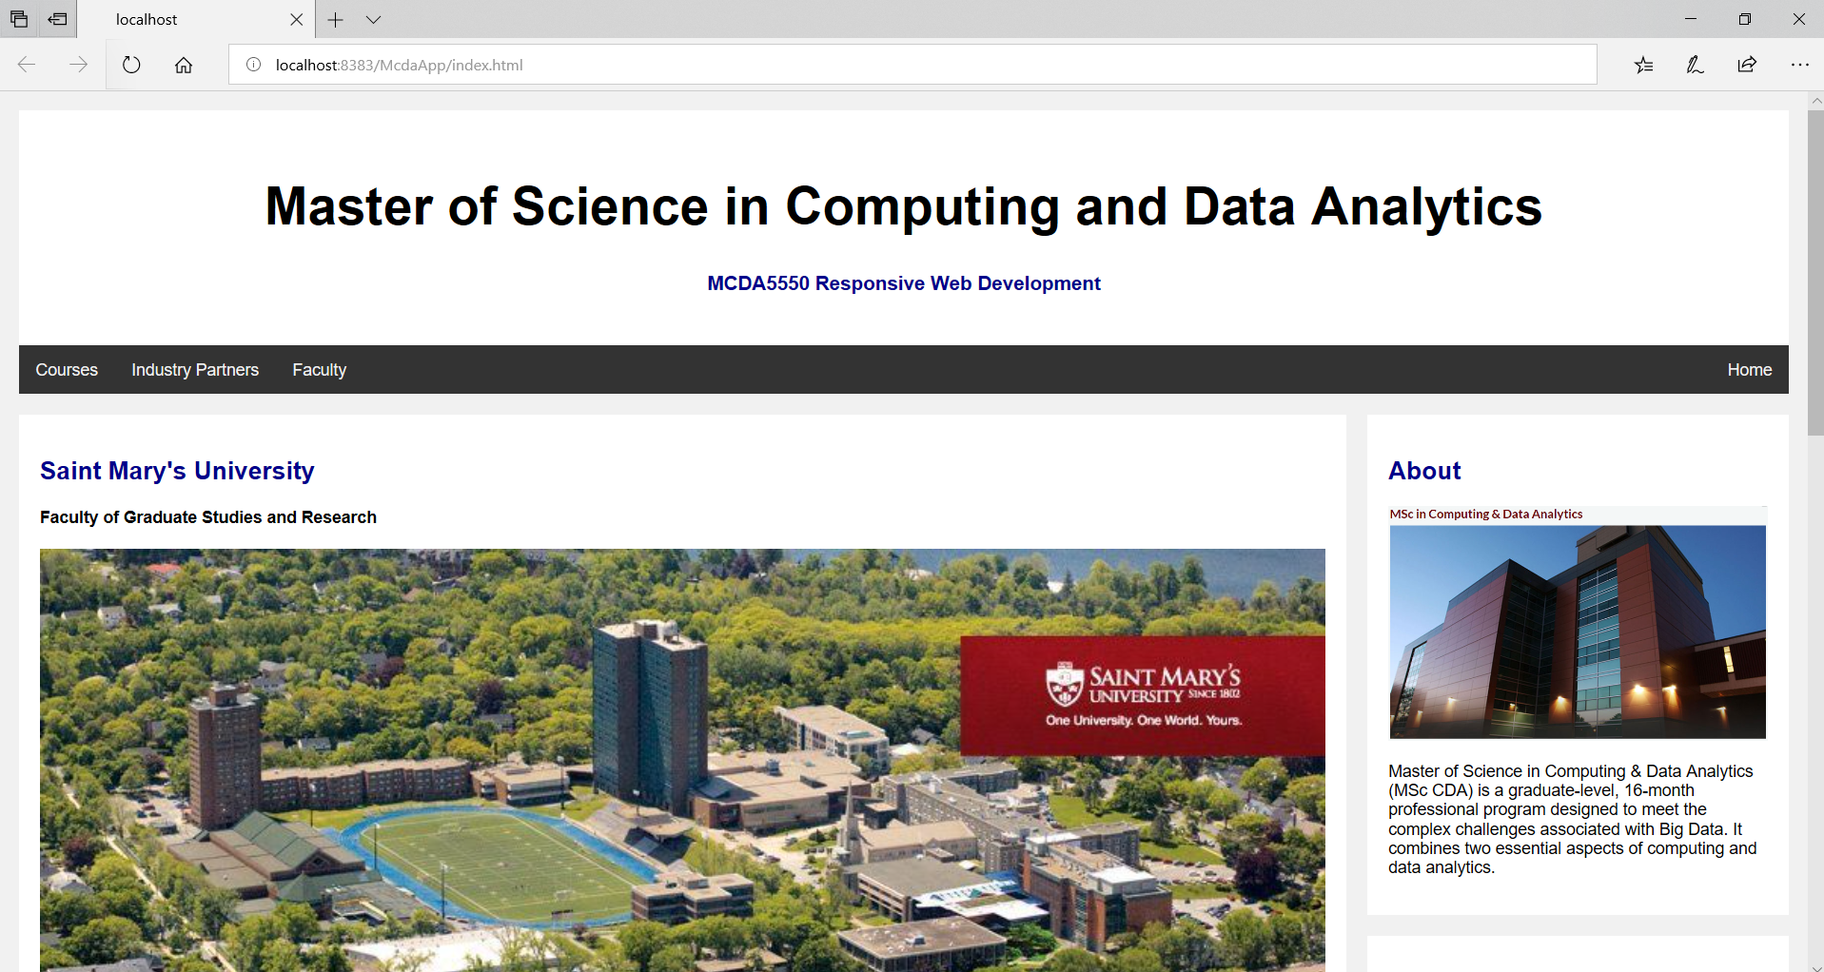
Mcda App – Edge

Slide 27
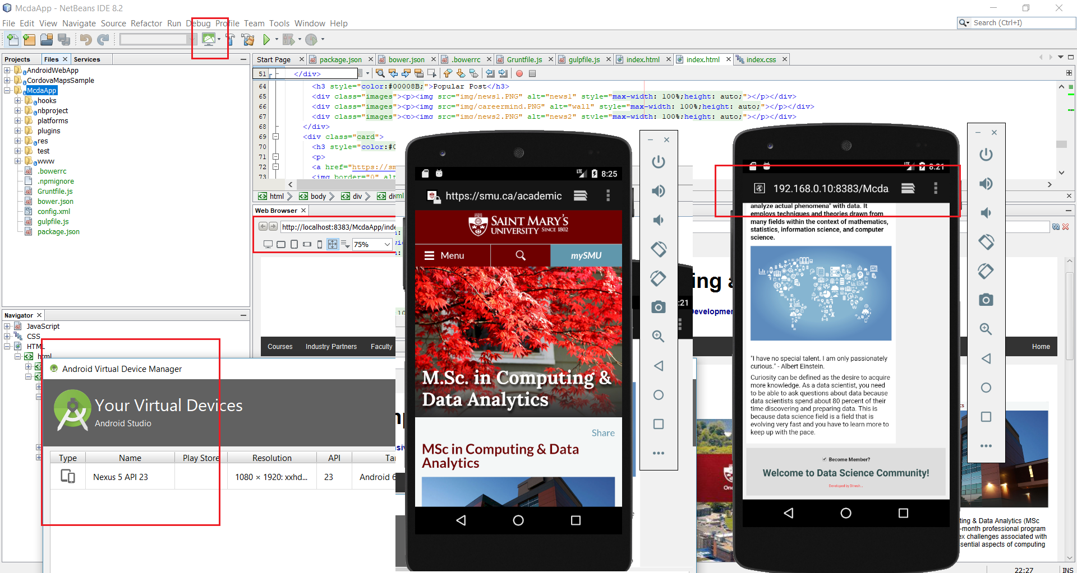
Emulator – Webhost …Nexus5

Slide 28
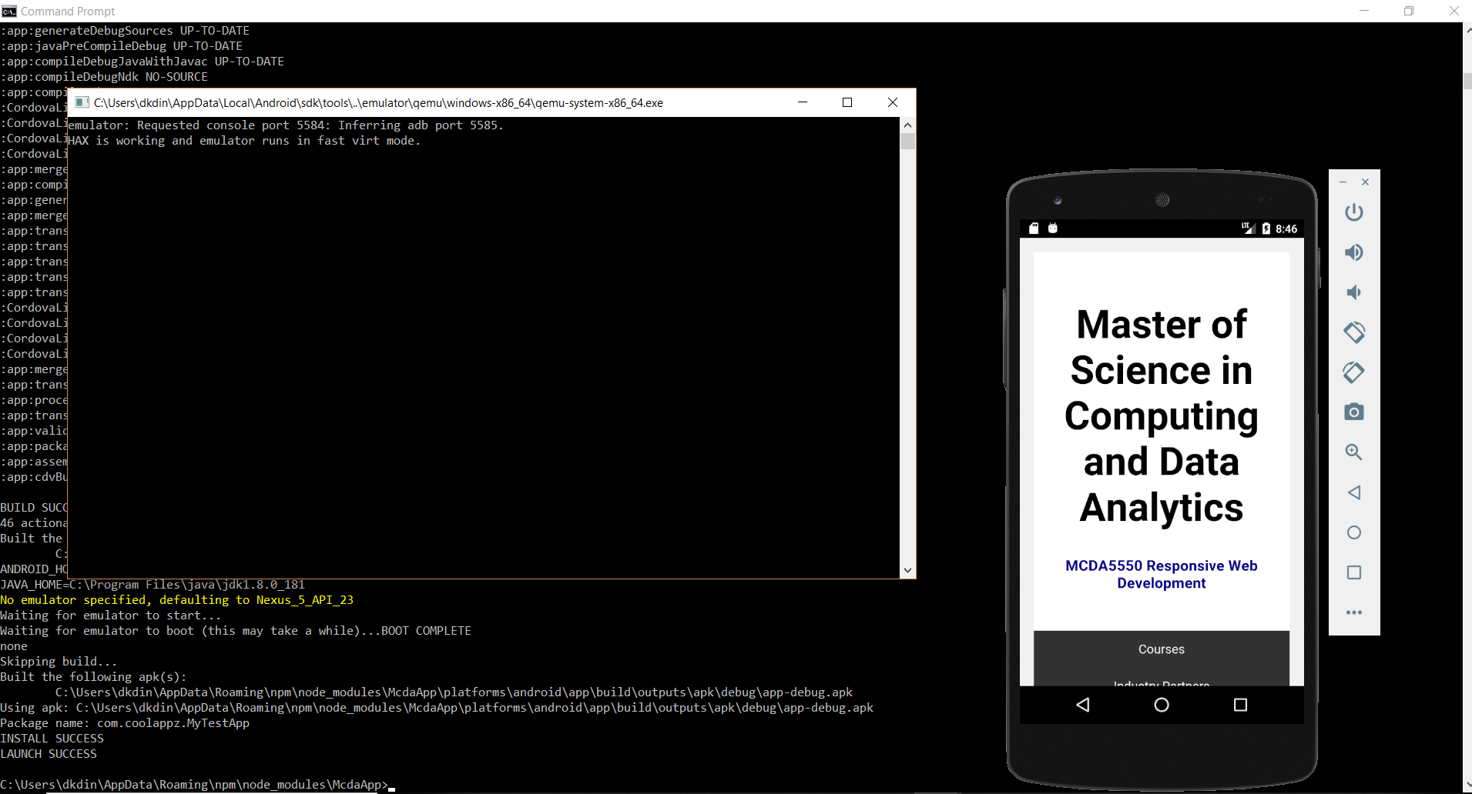
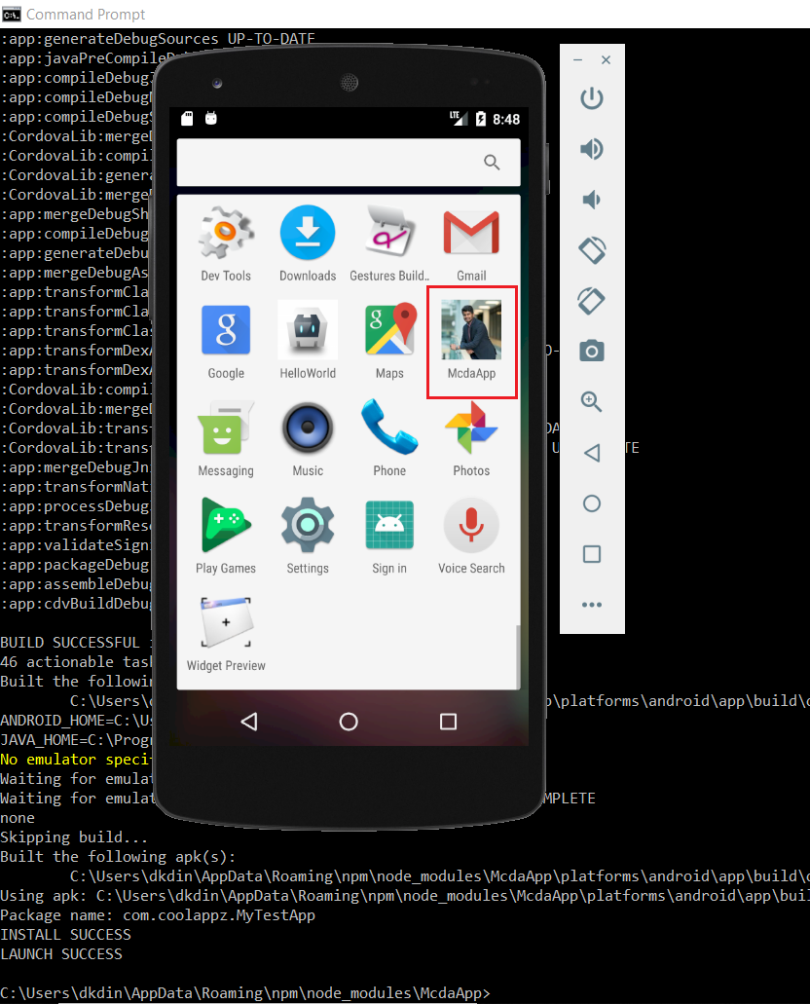
Emulator–Deployment …Nexus5

Slide 29
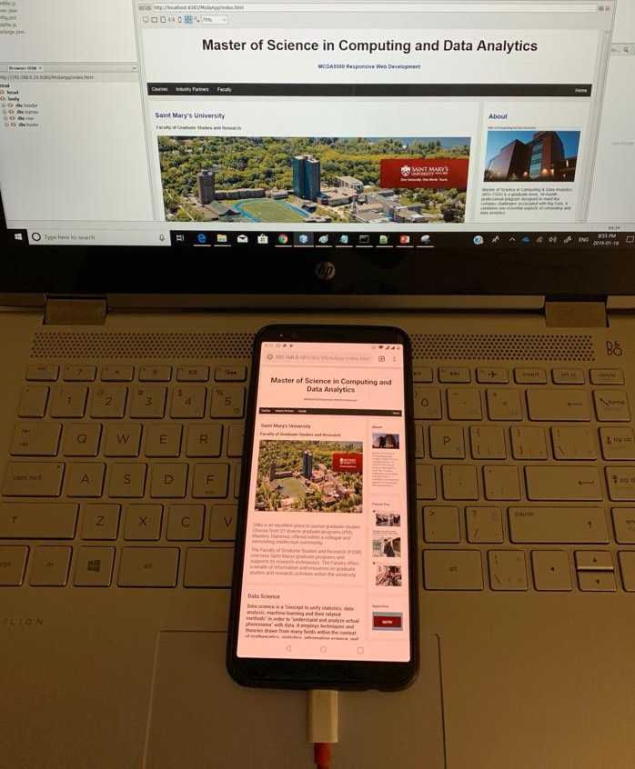
OnePlus5– USB&Webhost

Slide 30
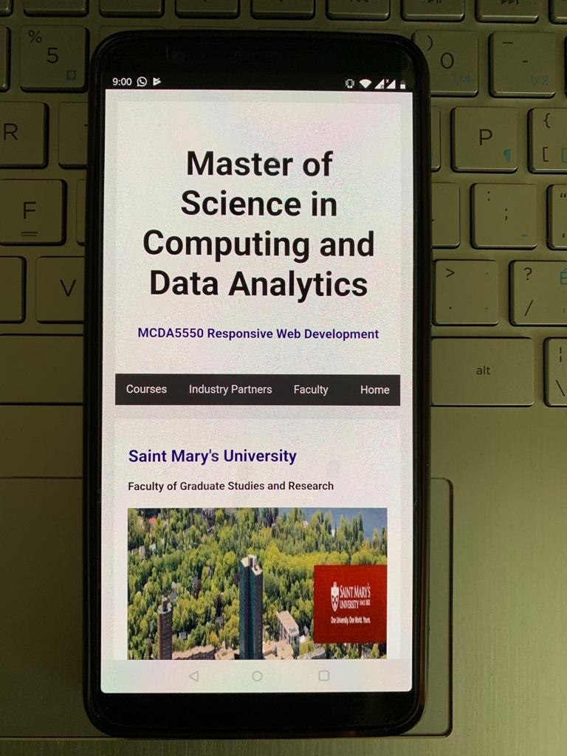
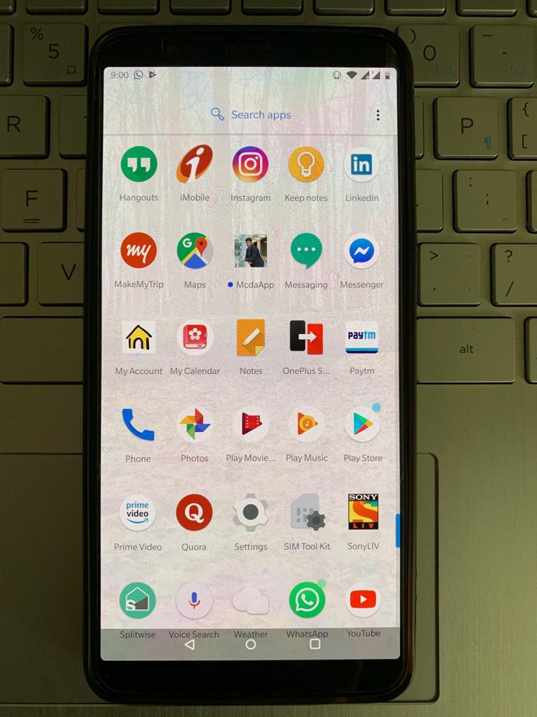
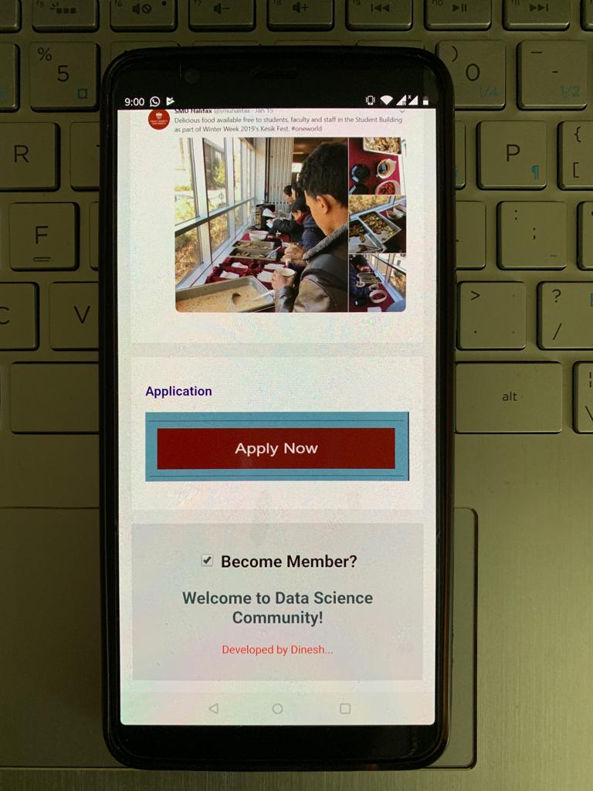
OnePlus5-Deployment-USB/Wifi

Slide 31
HTML5
Hypertext Markup Language
Creates the basic structure
HTML5 is response to the changing nature of the Internet
New tags (elements)
<video>, <audio>, <canvas>
<section>, <article>, <header>, <nav>

Slide 32
CSS3
Cascading Style-Sheet (Used for styling)
Used for describing the presentation of a document written in a markup language (e.g., HTML, XML, etc)
Separation of presentation (CSS) and content (HTML)
Consistency in design

Slide 33
JavaScript
NOT Java! (similar syntax but 2 distinct languages)
Responsiveness
01
(Primarily) For web-browsers to allow interactions and animate elements
02
Interpreter: instruction translated to executables as it goes
03

Slide 34
Objective
We’ll create mobile apps using:
HTML5
CSS3
JavaScript
Popular libraries such as jQuery and node.js
Database (mongoDB)

Slide 35
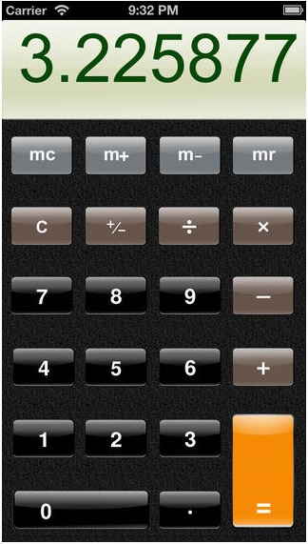
Common navigation methods
Single View

Slide 36
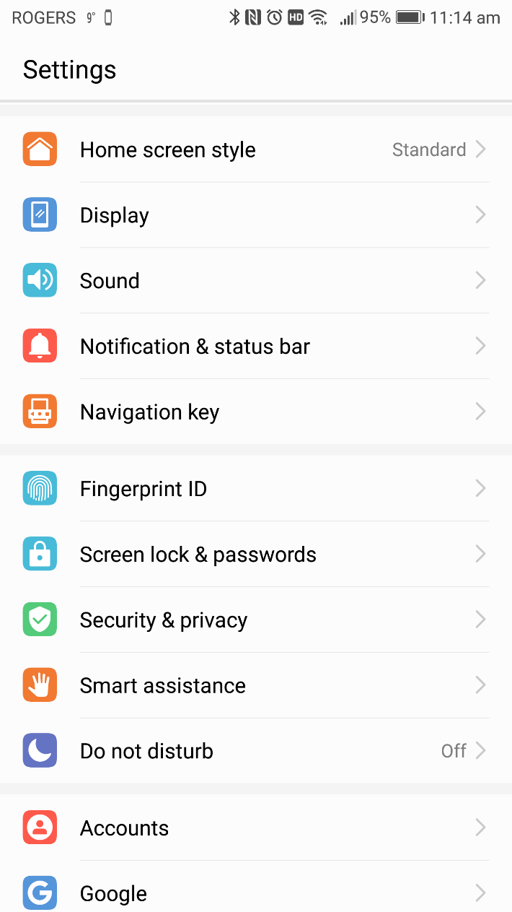
Navigation methods (cont’d)
Stacked navigation bar
Action Bar (Android)
Navigation Bar (iOS)

Slide 37
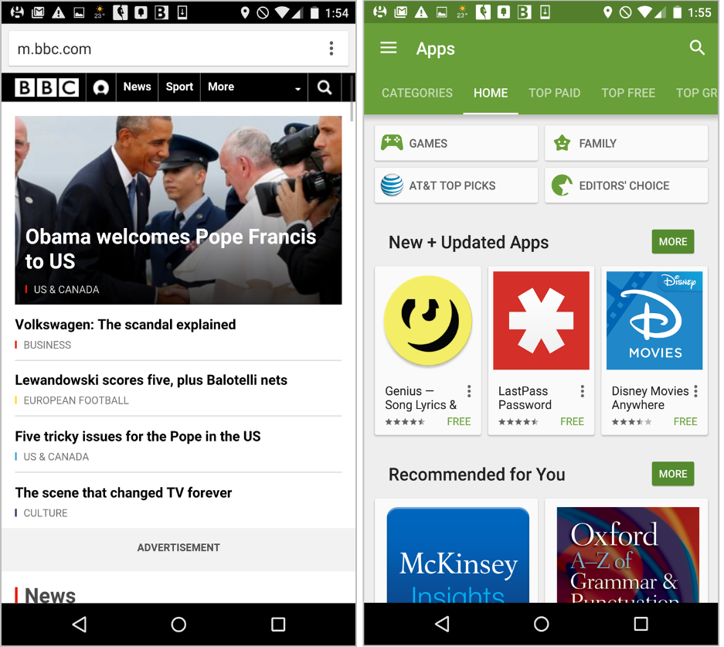
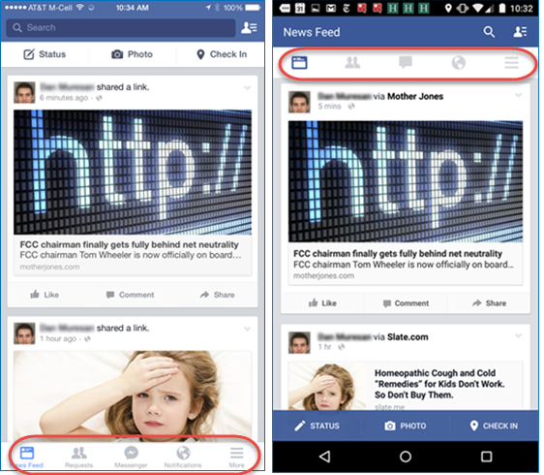
Navigation methods (cont’d)
Horizontal navigation bar (tab bars etc)

Slide 38
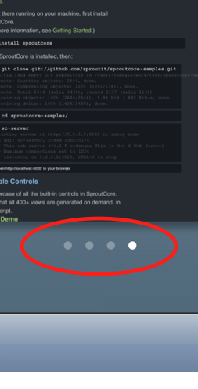
Navigation methods (cont’d)
Scroll views

Slide 39
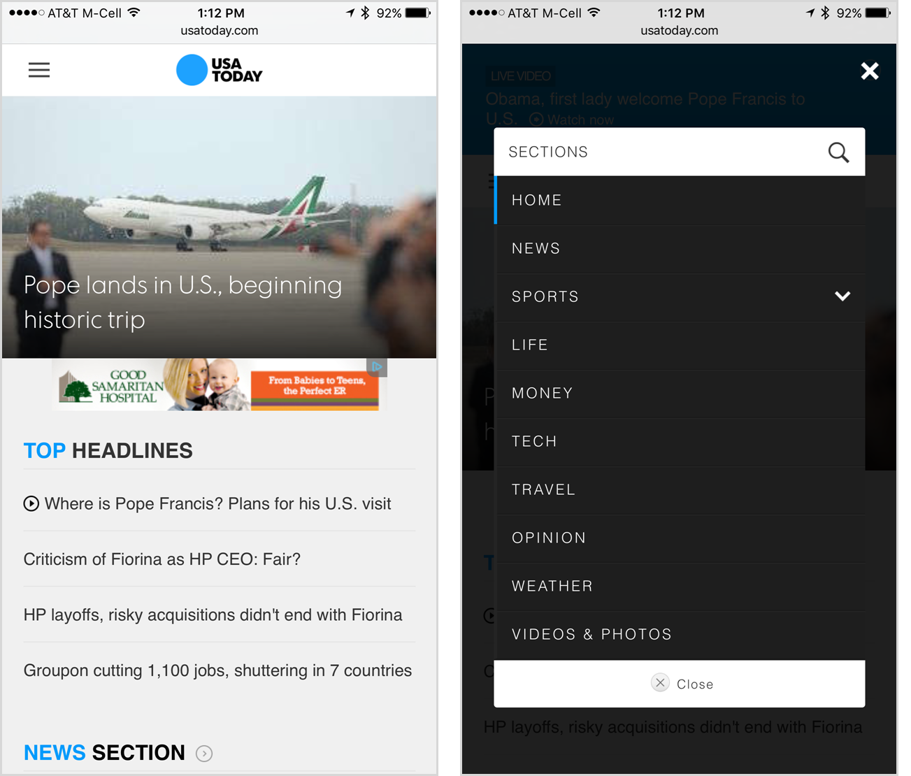
Navigation methods (cont’d)
“Hamburger” (and variants)

Slide 40
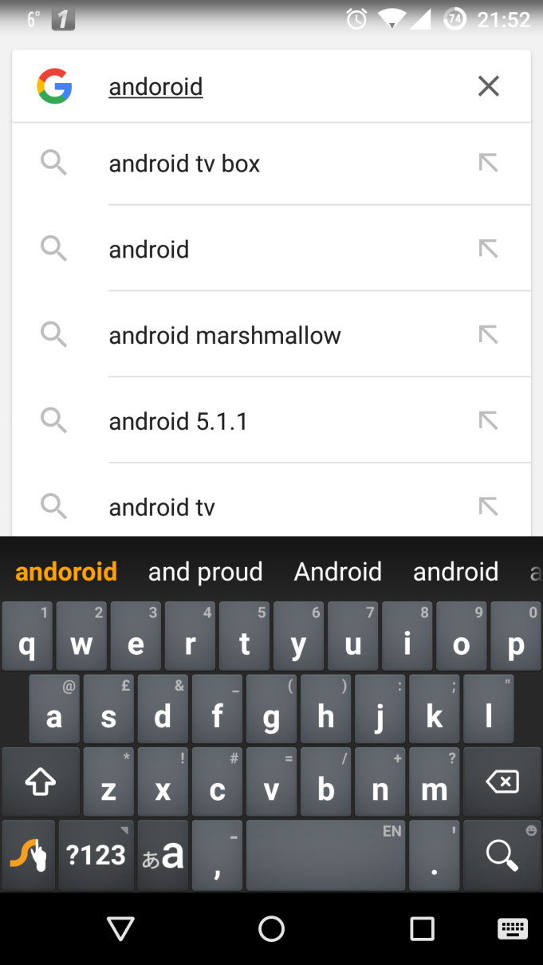
Navigation methods (cont’d)
Search-driven

